Slide 1
Building Multi-Tenant ASP.NET Core Applications & the ABP Framework
Alper EBİÇOĞLU
Co-Founder of Volosoft.com
Notes:
Ladies and gentlemen Thank you for joining me today.
I’ll be talking about multi-tenancy on ASP.NET Core.
My name is Alper, and I'm one of the co-founders of Volosoft.
Our company has been empowering .NET developers by creating frameworks and simplifying the complexities of software development,
One of our flagship projects is the ABP Framework, modular, multi-tenant and microservice compatible framework.
we have a good experience of multi-tenancy implementation in the framework level.
Today, I will share my real world experiences and insights I've gained while implementing the multi-tenancy requirements.

Slide 2


What is ABP Framework?
🚀
Your Application
do what you do best
Focus on your business code
Multi-tenancy
Audit logging
Exception handling
Background jobs
Modularity
Event bus
Unit of work
etc…
ABP Web Framework
An opinionated architecture to build line-of-business web apps
Routing
Dependency injection
Session management
Request / response
Security
etc…
ASP.NET Core Web Framework
Generic web framework
Notes:
Raw ASP.NET Core is Generic and provides essential features.
And ABP Framework is built on top of ASP.NET Core.
It is an opinionated framework that provides an architecture for building enterprise-level software.
It implements CROSS CUTTING CONCERNS like ex handling, caching, localization, validation, transaction management, social media logins, forgot password.
You can focus on your business logic in the green layer and write the business logic code of your applications such as CRM, HRM, ERP here.

Slide 3
Agenda
Introduction to SaaS & Multi-Tenancy
Pros and Cons of Multi-Tenancy
Database & Deployment Scenarios
Identifying and Changing the Active Tenant
Data Isolation
Conditionally Turning Multi-Tenancy On / Off
Handling Database Migrations

Slide 4
What is Multi-Tenancy?
A common approach to build SaaS solutions
Resources are shared between tenants
Application data is isolated between tenants
Tenants: Our clients, using the service
Host: Service provider
Parties
Notes:
Multi-tenancy is an architectural approach to build SaaS projects.
Hardware + Software resources shared btw tenants.
Tenant's data and configurations are logically or physically separated.
→ Tenants: Customers --- Host: Solution owner
→ Unaware of multi-tenancy :
You app code should be multi-tenancy unaware as much as possible.
And deployable to on-premise.

Slide 5
Advantages of Multi-Tenancy
Cost efficiency — max utilization
Consistent user experience
Ease of maintenance
Scalability
Rapid deployment for new users
Notes:
Cost Efficiency: You share the hardware and software resources among customers, you reduce costs and serve the maximum number of customers.
Consistent User Experience: All your customers use the latest version. So, we as developers, can focus on maintaining a single codebase, ensuring all tenants receive updates and improvements at the same time.
Ease of maintenance: Maintaining a single codebase and infrastructure for all tenants simplifies software updates, patches, and bug fixes. It reduces the complexity of managing multiple instances, making it easier for developers and administrators to maintain the system.
Scalability: When there are demand spikes, you can easily increase system resources. You can add extra servers behind your load balancer. This way, you can serve more customers.. This leads to better resource utilization and responsiveness to demand spikes.
Ease of Deployment: New tenants can be onboarded quickly within the existing infrastructure, you don’t need to set up a new environment for the new client. When a new tenant comes, you just add a new line into your Tenants table.

Slide 6
Challenges of Multi-Tenancy
Data isolation
Configuration & customization per tenant
Performance balance: Noisy neighbors!
Security
Backup and recovery
Notes:
Data isolation: You must ensure, you provide a proper data isolation btw tenants to prevent unauthorized access.
Customization and configuration: Your clients may request to customize the application according to their requirements. They want to make rebranding and customize the UI, logo, colors. Managing different configurations and customizations for each tenant without compromising the core architecture can be challenging.
Performance balance: some customers may use the system extensively We call this “Noisy neighbors“.. We should ensure that the resource usage of one tenant does not negatively impact the performance of other. This should be done by monitoring the system.
Security: Also if you have a security hole, a tenant can gain access to all your tenant’s data.
Backup and recovery: This involves database and storage backup per tenant. It will be very easy to backup/restore when you have a separate DB for each tenant, but if you have a shared DB then you need to get backup of the specific tenant. You need to write custom queries to fetch the corresponding tenant's data from all tables. And also this backup file must be restorable. And tenants may have different retention policies, so you need to implement different strategies for each tenant for example for Government agencies & banks

Slide 7



Deployment & Database Architectures
1
2
3
4
Separate App
Separate DB
Shared App
Separate DB
Shared App
Shared DB
Hybrid
APP
APP
APP
APP
APP
APP
DB
DB
DB
DB
DB
DB
DB
DB
DB
Notes:
on-premises deployment. Not SaaS friendly architecture
Not good for resource utilization. Migrating databases at the same time is hard!
Ideal scenario! SaaS friendly + Min cost & Max Utilization + Customers will ask you to separate their DB (banks, government agencies)
Covers all kinds of requirements. If pays more separate DB

Slide 8
Maintaining Application States
Application code & services should be stateless!
Where should we save the state?🤔
HTTP Request (cookie, header, query string, payload)
Authentication ticket
Database
Distributed cache
Notes:
As you know the HTTP is a stateless protocol. This means that user data is not persisted from one web page to the next.
And our multi-tenant web app should also be stateless.
Besides, the stateless approach is multi-thread friendly!
Then where should we save the state?
In HTTP Requests, Authentication tickets (claims) as in JWT, DB, Distributed caches like Redis, Memcached.

Slide 9
Identifying the Active Tenant
Notes:
So far I gave you some general information about multi-tenancy.
Now let’s see some code and real-world solutions

Slide 10
Identifying the Active Tenant
How to specify the current tenant?🤔
Authentication Ticket
Query String
Route
Header
Cookie
Domain
Notes:
When a user makes a request to the application, you need to understand Which tenant's user is this user?
In ABP we are following these 6 approaches to detect the current active tenant.

Slide 11
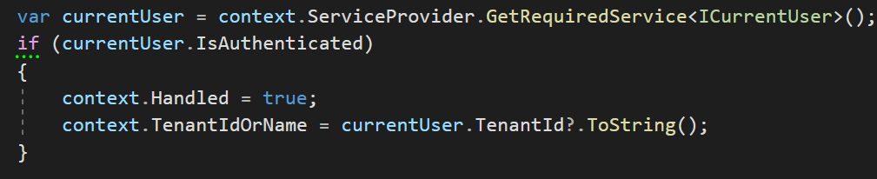
Identifying the Active Tenant
1. Authentication Ticket (JWT)
HttpContext.User.Identity.Claims .FirstOrDefault(c => c.Type == “TenantId”)
Notes:
When a user logs in, we save his TenantId to the claims.
And when user comes back again, we identify the user from this TenantId that’s retrieved from the claims.

Slide 12
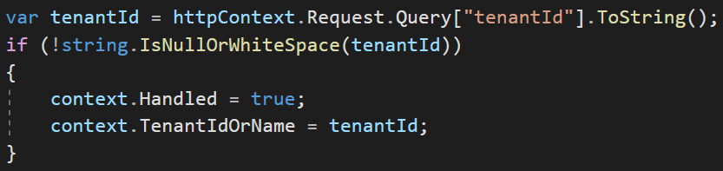
Identifying the Active Tenant
2. Query String
https://fabrikam.com?tenantId=3

Slide 13
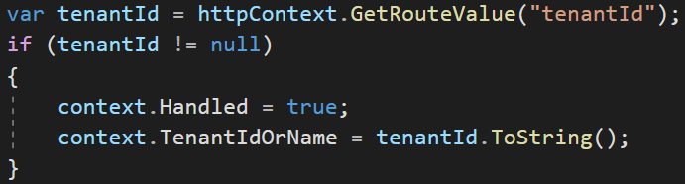
Identifying the Active Tenant
3. Route
https://fabrikam.com/acme/
Notes:
Store tenantId as route path

Slide 14
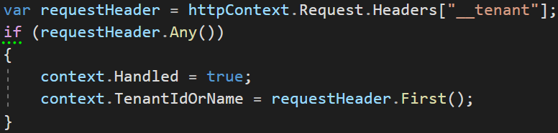
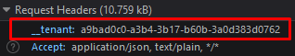
Identifying the Active Tenant
4. Header
Notes:
We use headers especially for SPA or 3rd party clients like mobile apps.

Slide 15
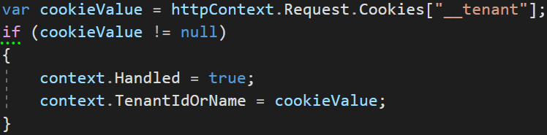
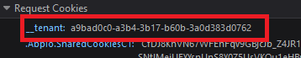
Identifying the Active Tenant
5. Cookie

Slide 16
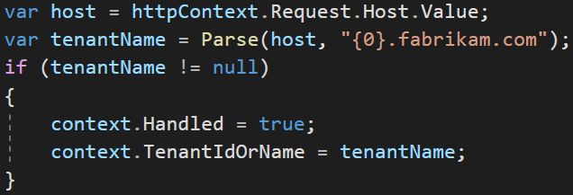
Identifying the Active Tenant
6. Domain
https://acme.fabrikam.com
Notes:
This is good if your customers make e-commerce, online shopping etc.

Slide 17
Data Isolation
✓ Identifying the Active Tenant
Notes:
So far we understand who the tenant is, now let's look at data isolation.

Slide 18
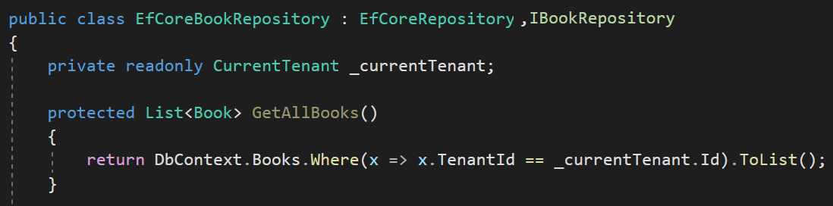
Data Isolation — Traditional way
You normally do this

Slide 19
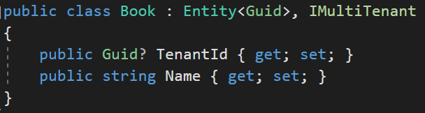
Data Isolation
Notes:
We use IMultiTenant interface to make an entity multi-tenant.
By using this interface, we make the TenantId field standard so that we can easily filter or set the TenantId automatically.

Slide 20
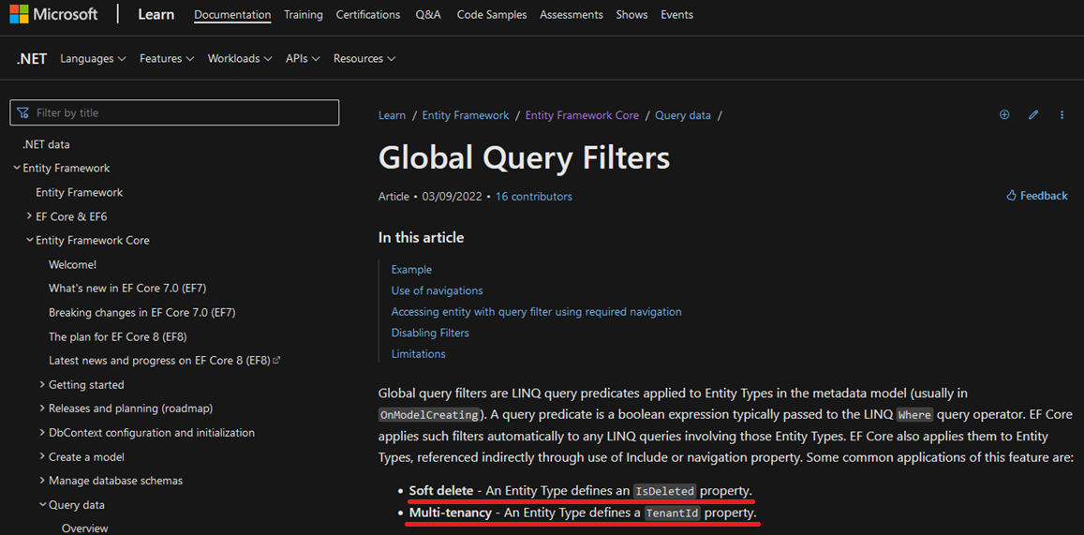
Data Isolation — EF Core
Soft delete: An Entity Type defines an IsDeleted property.
Multi-tenancy: An Entity Type defines a TenantId property.
Notes:
Allows you to define a filter condition that is automatically applied to all queries for a given entity.
These filters are LINQ expressions that applies to Entities OnModelCreating phase.
This feature is generally being used for soft deleting an entity or multi-tenancy.

Slide 21
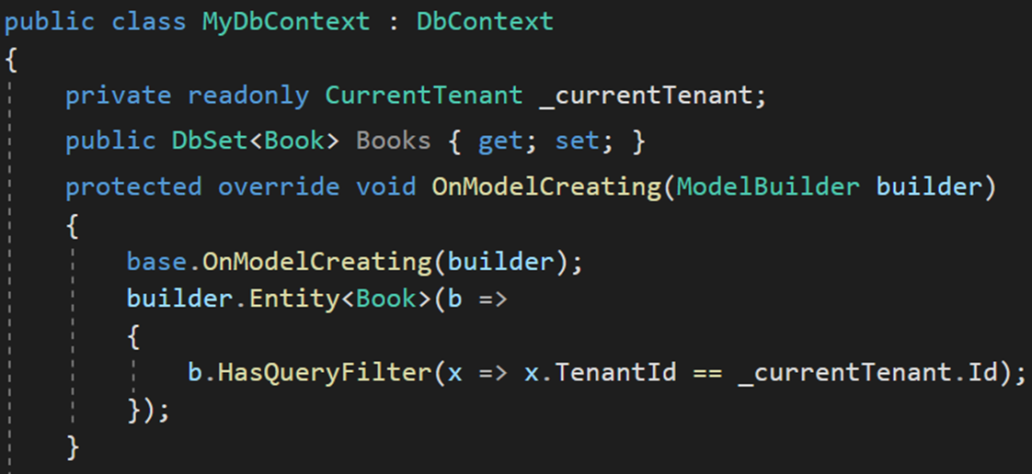
Data Isolation — EF Core Manual Way
HasQueryFilter() for global filtering
Notes:
In traditional way, you need to use HasQueryFilter for all your multi-tenant entities in OnModelCreating method of the DbContext.
Let's see how we automate this in the framework.

Slide 22
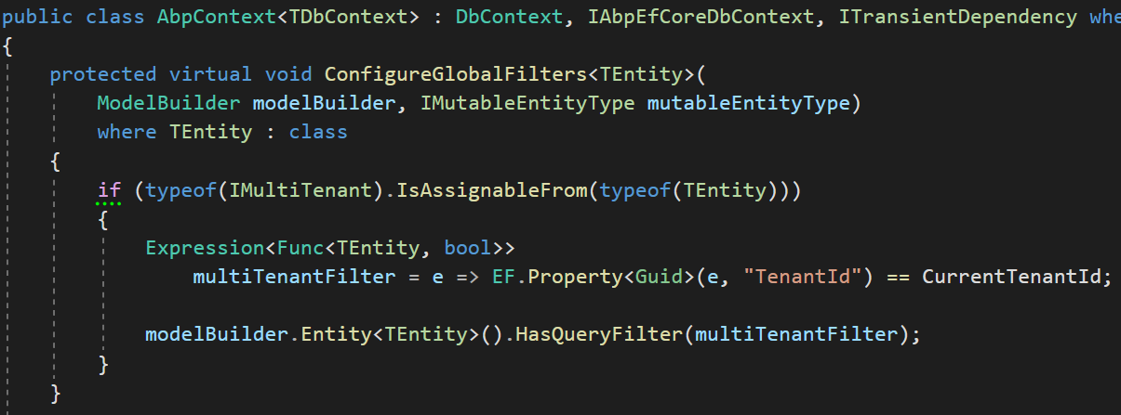
Data Isolation – EF Core
1-) Find all entities implement IMultiTenant
2-) Create LINQ expression
3-) Add to global filters
Notes:
To filter the multi-tenant entities by default we are using this simplified code snippet in the framework.
We find all entities that implement the IMultiTenant interface.
We create a LINQ filter expression for this entity
And we provide this filter query to the HasQueryFilter method.
(it is well integrated to EF Core and works as expected even if you directly work with DbContext.)

Slide 23
Data Isolation — EF Core PROS & CONS
😊 Easy to implement
😊 Supports navigation properties as well
😕 Works only with EF Core
Notes:
Plan to change your ORM later, doesn’t work for other ORM!

Slide 24
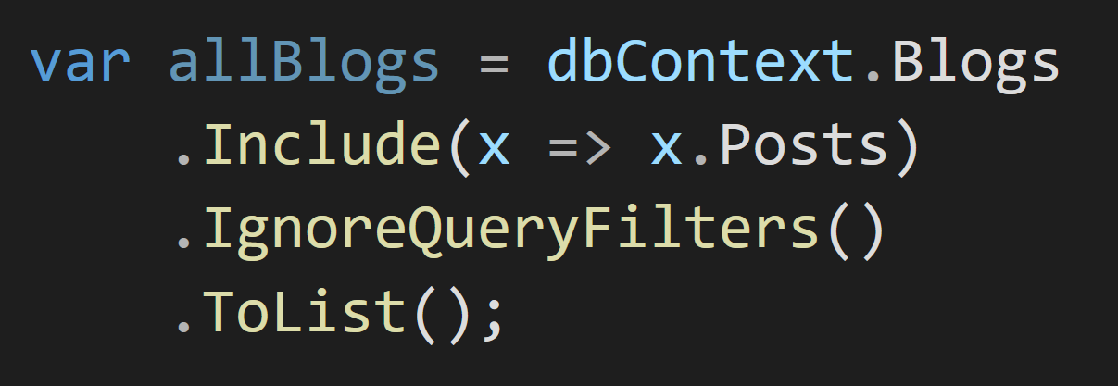
Data Isolation — EF Core PROS & CONS
😡 IgnoreQueryFilters() disables all filters
Notes:
There’s nice feature to disable filters called IgnoreQueryFilters.
But currently it’s not possible to disable a specific filter with IgnoreQueryFilters method.

Slide 25
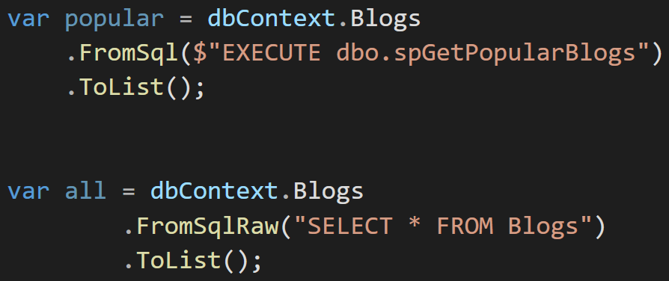
Data Isolation — EF Core PROS & CONS
😡 Does not support Stored Procedures or T-SQL
Notes:
When you want to use Stored Procedures or Run raw SQL statements, Global Query Filters are ignored.

Slide 26
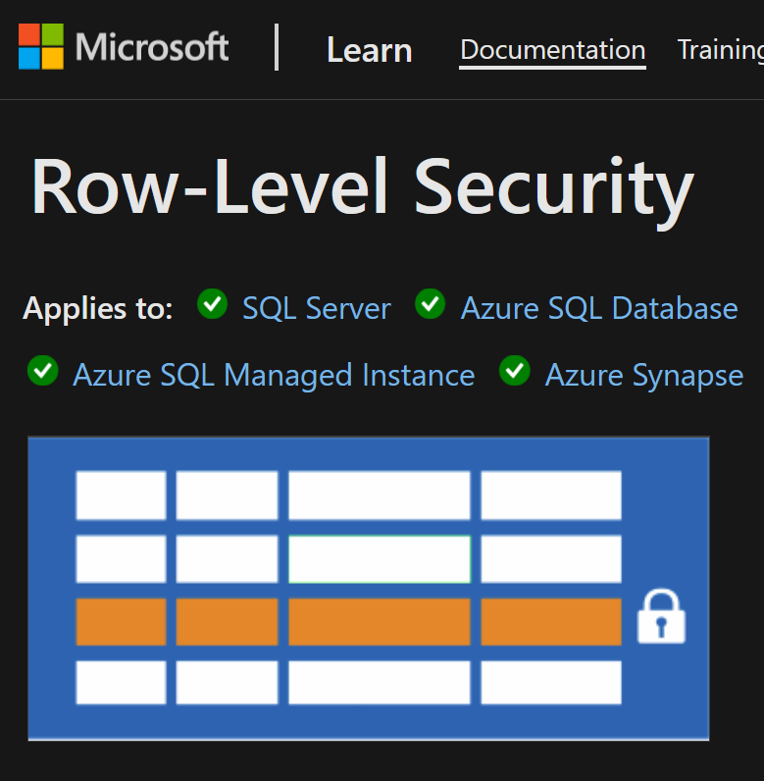
Data Isolation — EF Core PROS & CONS
Database level solution
👉 Row Level Security
Rows filtered based on user roles, attributes
Restriction logic is done in the DB
https://learn.microsoft.com/en-us/sql/relational-databases/security/row-level-security
Notes:
If you want to cover all these downsides, you can use Row Level Security.
It applies to SQL Server and Azure SQL Database.
Multi-tenant filters work, even if you open SQL Management Studio and write raw SQL queries.
But Row Level Security is relatively complex to implement and you have to stick with SQL Server.
So for me, EF Core Global filters method is ideal for a pragmatic solution.

Slide 27
Set TenantId for New Entities
✓ Identifying the Active Tenant
✓ Data Isolation

Slide 28
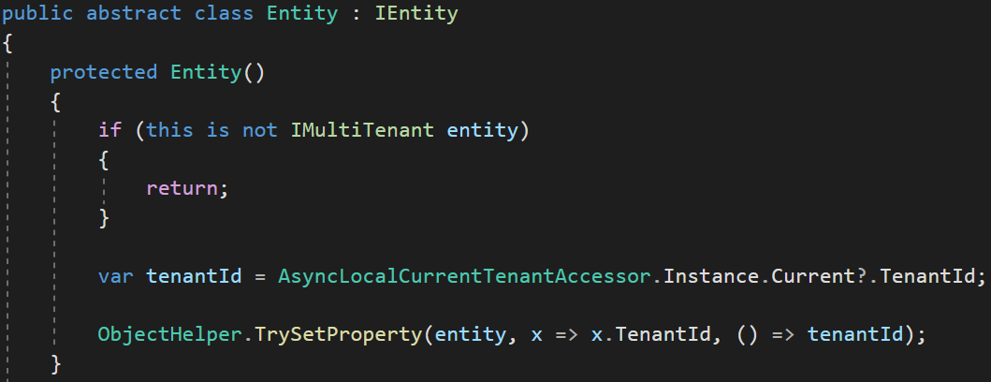
Set TenantId for New Entities
Set TenantId by reflection
Notes:
In the framework, we have base abstract class called Entity.
To avoid human mistakes, we set the TenantId automatically in the framework level.
We added a protected constructor with empty parameters.
We get the active TenantId from the active tenant’s scope and set via reflection.
This way we are sure that TenantId is always being set correctly.

Slide 29
DB Connection String Selection
✓ Identifying the Active Tenant
✓ Data Isolation
✓ Set TenantId for New Entities
Notes:
When you allow your tenants to have separate DB, then you need to deal with DB Connection String Selection

Slide 30
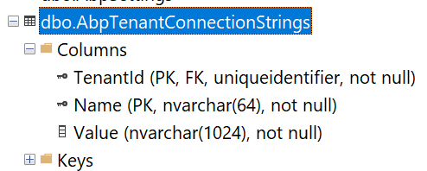
Connection String Selection via DB
The current tenant
The current module / microservice
The default connection string
Fallback
Notes:
In the framework, we have a table called TenantConnectionStrings.
If a tenant has a separate database then we store its connection string in TenantConnectionStrings table with TenantId.
The framework first checks this table then fallbacks to the current module’s configuration.
Finally, it checks the connection in the main application’s connection string, which is located in appsettings.json file.
This way we setup a hybrid approach for both shared and dedicated database architecture.

Slide 31
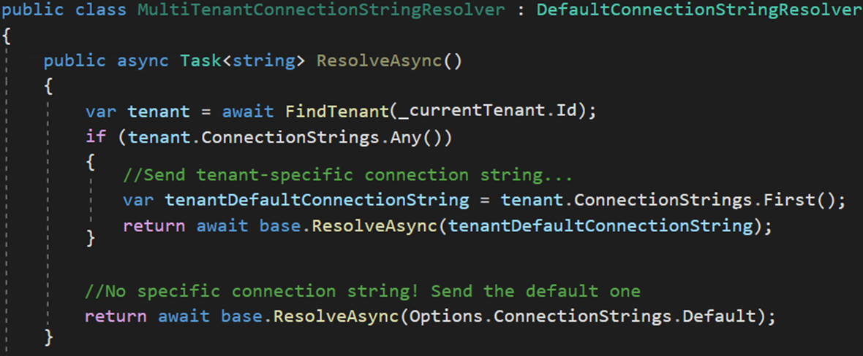
Connection String Selection via Code
Dedicated DB
Shared DB
Notes:
This is our implementation. I simplified the code a bit for your focus.
We use a factory service to dynamically set the connection string when the DbContext is being created.
We use DbContextCreationOptions for this approach
https://learn.microsoft.com/en-us/dotnet/api/microsoft.entityframeworkcore.dbcontextoptionsbuilder?view=efcore-7.0

Slide 32
Changing the Active Tenant
✓ Data Isolation
✓ Set TenantId for New Entities
✓ DB Connection String Selection
Notes:
Sometimes you need to change the active tenant.
For example when you have background job that generates reports for each tenant.
Or it may require it in a Windows Service where there is no HTTP request.

Slide 33
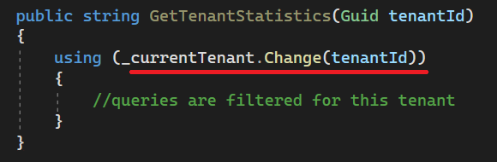
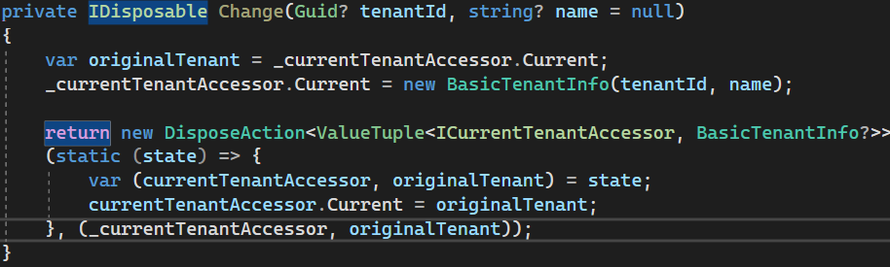
Changing the Active Tenant
Set active tenant
Revert back
Notes:
In this case, we use a disposable method called “Change” on the Current Tenant object.
Here we keep the original tenant in a temporary variable and then we set the new tenant.
Then we restore the original tenant after when the using code block finishes.

Slide 34
Temporarily Disable Multi-Tenancy
✓ Identifying the Active Tenant
✓ Data Isolation
✓ Set TenantId for New Entities
✓ DB Connection String Selection
✓ Changing the Active Tenant
Notes:
When tenants share the same database, you may want to run queries on all tenants.
Especially for generating cumulative reports among your tenants.

Slide 35
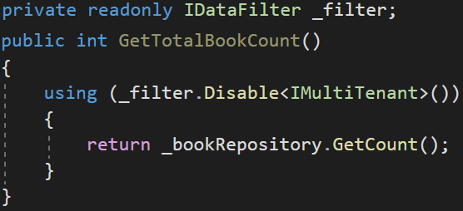
Temporarily Disable Multi-Tenancy (Usage)
Returns book count without TenantId filter
Notes:
When you want to query on all tenats’ data, you need to disable the multi-tenancy filter on
In this example we get all book count without tenancy filter.
We inject IDataFilter which holds all global filters.
And we run the Disable method of DataFilter object for a specific filter in the using code-block.
After the “Using” code block finishes, TenantId will be restored again.

Slide 36
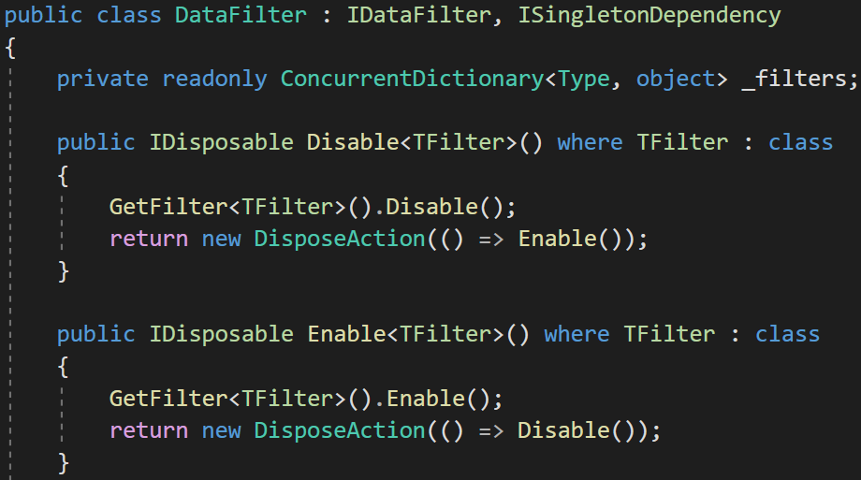
Disabling Multi-Tenancy Filter (Implementation)
Notes:
This is the simplified implementation we did in the framework.
We use a singleton class called DataFilter and we save all filters in a concurrent dictionary.
And each filter has a Boolean flag called IsEnabled.
Each time we add the global query filter we first check this flag.
It returns DisposableAction so that we restore the filter back.

Slide 37
Database Migration
✓ Identifying the Active Tenant
✓ Data Isolation
✓ Set TenantId for New Entities
✓ DB Connection String Selection
✓ Changing the Active Tenant
✓ Temporarily Disable Multi-Tenancy
Notes:
The last topic is database migration.
There are various approaches to migrating tenant databases.
Let's take a look at some of them.

Slide 38
Database Migration
Approach-1: Make DB migration with a custom tool
😊 Easy to implement. All tenants are in the same version
😡 May get too long time for big number of tenants and data.
😡 All tenants wait for all upgrade progress
Approach-2: Run migration on first DB access
😊 Upgrading is distributed to time. A tenant does not wait for another
😡 First user may wait too much and see timeout exception.
😡 Hard to implement (concurrency problems)!
Notes:
Approach 1:
you can easily migrate all tenant databases by creating a simple console application.
So that all tenants use the same version whenever you update the application.
If there is a lot of data in the tenant databases, the upgrade process may take a long time and in this case, all tenants will wait for this process.
Approach 2:
You migrate a tenant’s database whenever a user of the tenant interacts with the DB.
You suspend the first request and make the DB migration in the background, and resume the request and send the response.
This way only the relevant tenant wait for the upgrade process.
But if this process takes too much time, first user will get timeout exception.
Also there’ll be race condition.

Slide 39
Database Migration
Approach-3: Make two types application servers.
Upgraded tenants use the new application, other tenants use the old application
😊 Minimum wait time for a tenant
😊 Upgrading can be scheduled for tenants
😊 Run A/B tests and see bugs before anyone else
😡 Requires multiple app servers
😡 Hard to maintain and monitor
Notes:
You’ll have 2 types of application servers: the latest version and the previous version.
A tool can update the application servers and databases in the background.
When a user enters the system, if his database has been upgraded, you redirect him to the new system. If not, he’ll continue to use the old version.
You can achieve this by writing a rule to your load balancer.
When Gmail made a radical renovation in the UI, they made a similar approach.
While I was using the old version, my fellow was using the new UI.
And I received a notification that my app will be renewed soon.
This is the ideal way for big systems !

Slide 40





Thank you for listening
https://twitter.com/alperebicoglu
https://github.com/ebicoglu
open-source web application
framework
https://medium.com/@alperonline
Download this presentation:
https://github.com/ebicoglu/presentations
https://abp.io

